Slide 1

Application Project:
Dangerous good classification for the LHG
Torsten Brockhaus
Damilare Osunleke
Aleksei Trikoz

Slide 2
l. Contents
The task

Slide 3
The task:
Train a ML solution to classify dangerous goods labels on trucks and
deploy it in a Docker-Container

Slide 4
The data
Raw data
Six terabytes of data in total
Stored in four folders, one for each gate
One zip folder for each truck, that passed the gate
About fourty photos for a single truck
Only the pictures of the rear of the trucks was used
In total we collected a sample of 338.00 pictures of which we examined 70.000 manually

Slide 5
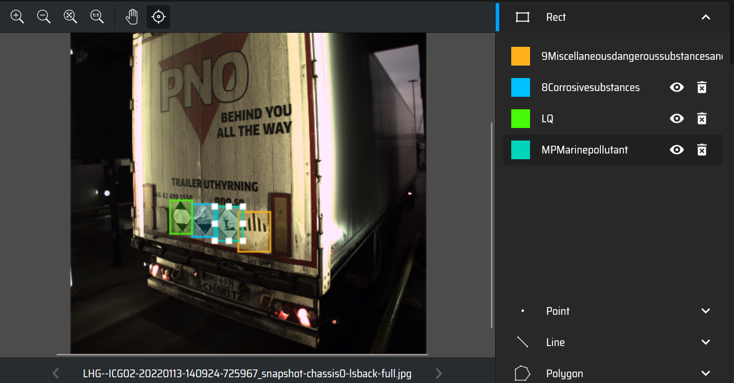
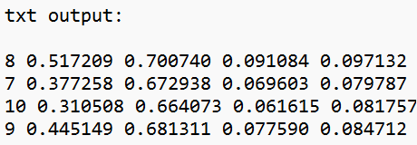
The data
Labeling

Slide 6
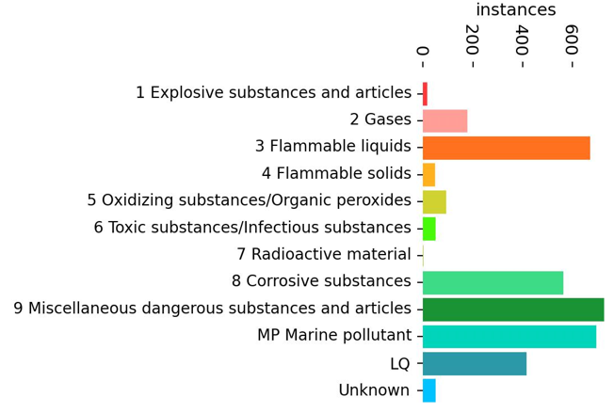
The data
Sample
Out of the 70.000 pictures, 2.470 pictures have atleast one sign on them????????
Sample ist heavily unbalanced
Higher sample size led to a higher accuracy

Slide 7
The model
YOLOv5
Acronym for “You only look once“
First model developed by Redmon et al. in 2015
Version 5 released in 2020
Can predict multiple bounding boxes and class probabilities
Offers high speed, processing images in real-time with minimal latency
Pretrained on the COCO dataset
Able to be fine-tuned on custom datasets
Inbuilt image augmentation

Slide 8
The model
Training
Of the 2.470 images, 2.270 were used for training, 200 for testing
265 images without sings added to reduce False Positives
For training powerful hardware, especially GPU‘s are required
Due to a lack of powerful hardware, training was done on Google Colab
Google Colabs offers a limited access to powerful CPU‘s, GPU‘s and RAM
For 100 epochs in 16 batches the total run time in Google Colab was about 3.5 hours

Slide 9
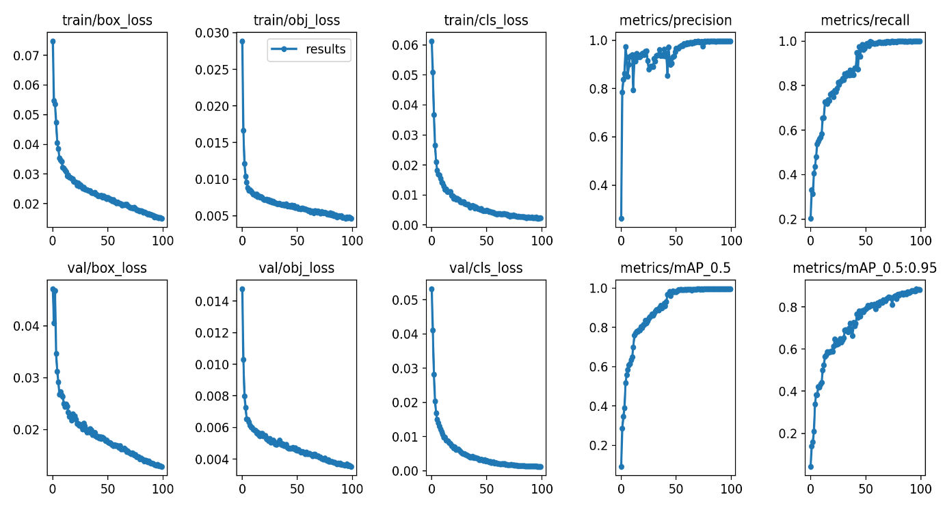
The model
Training results
Increasing the epochs to 200 did not significantly improve the model's performance.

Slide 10
The model
Test results
Class | Instances | Precision | Recall | mAP50 | mAP50-95
all | 135 | 0.902 | 0.915 | 0.951 | 0.793
2 Gases | 8 | 0.807 | 0.75 | 0.781 | 0.723
3 Flammable liquids | 23 | 0.876 | 1 | 0.976 | 0.782
5 Oxidizing substances | 5 | 0.962 | 1 | 0.995 | 0.906
6 Toxic substances | 3 | 1 | 0.778 | 0.995 | 0.764
8 Corrosive substances | 19 | 0.896 | 0.905 | 0.964 | 0.771
9 Miscellaneous dangerous | 28 | 0.923 | 1 | 0.988 | 0.815
MP Marine pollutant | 31 | 0.935 | 1 | 0.995 | 0.844
LQ | 18 | 0.82 | 0.889 | 0.917 | 0.741

Slide 11
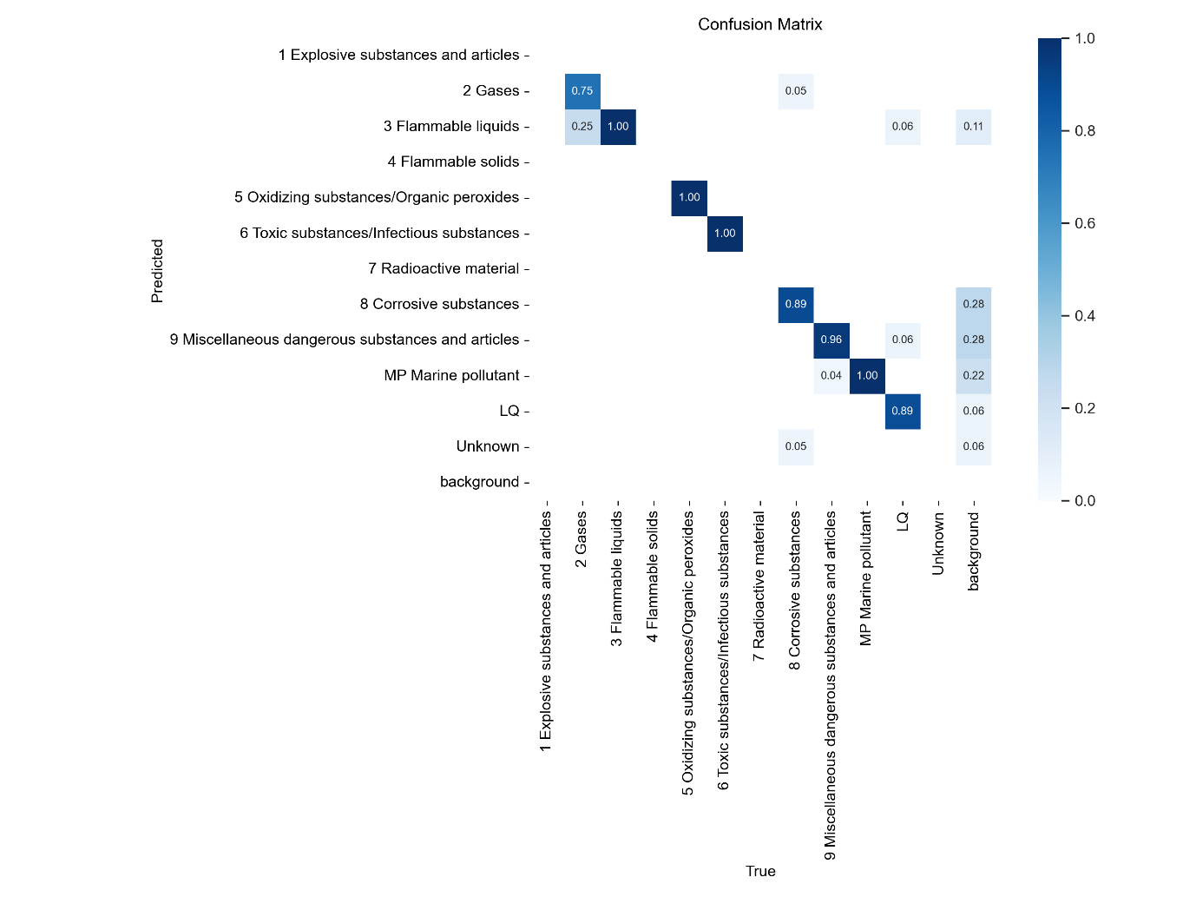
The model
Test results

Slide 12
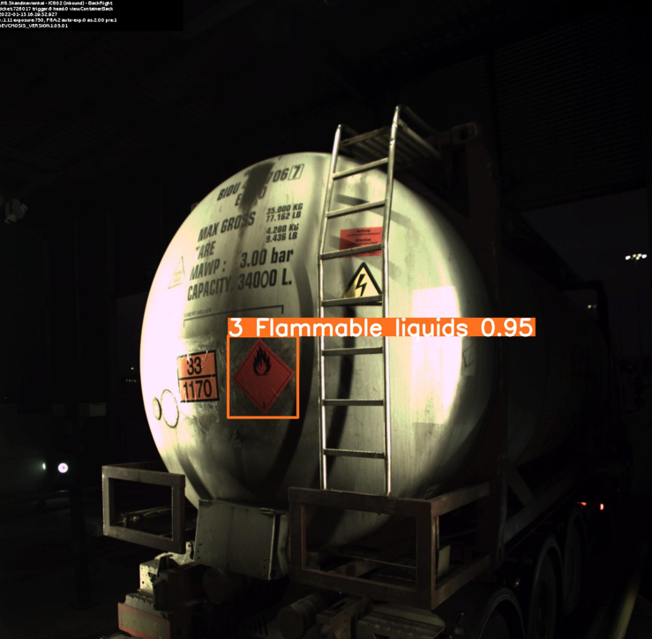
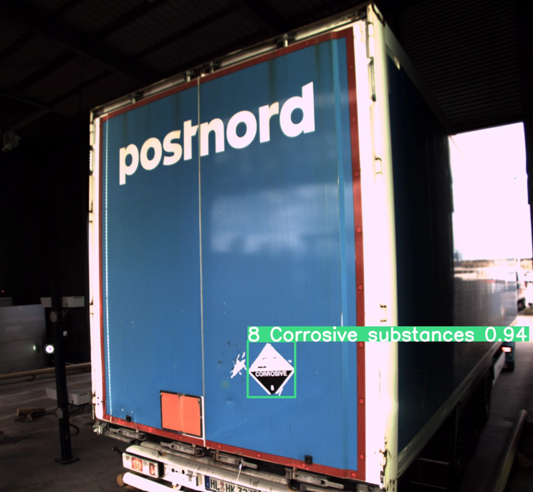
The model
Examples

Slide 13
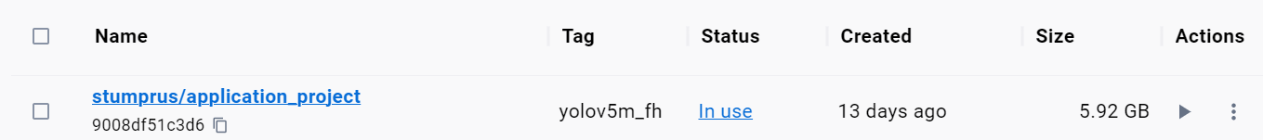
Deployment
Model deployment
BentoML platform was used for deployment
Model was containerized as a docker image (5.92 GB)
Can be downloaded and run on local machines

Slide 14
Recommendations and next steps
The recommendations below are based on the outcome of the project:
Adopt this model for identifying dangerous goods labels on trucks.
In the meantime, perform second-level checks when label 2 is detected. This is due to relatively low recall for that class and its misidentification as label 3.
Retrain the model, but split label 2 into its constituent sub-labels before training
Integrate the model with the existing booking data from the LHG logistics system for auto verification

Slide 15
Sources
https://www.fh-kiel.de/typo3conf/ext/fh_kiel/Resources/Public/Images/News/fachhhochschule-kiel-campus-ecke.jpg

